Slide 1

Basic Details of the Team and Problem Statement
Ministry/Organization Name/Student Innovation:
PS Code: Problem Statement Title: Team Name: Hustlers
Team Leader Name: Radha Krishna Garg
Institute Code (AISHE): Institute Name: Vellore Institute of Technology, Amaravati
Theme Name:

Slide 2





Idea/Approach Details
Describe your idea/Solution/Prototype here:
SheSafe is an essential women's safety application designed for urban women of all ages. It offers a dual-alert system, notifying both close contacts and the police at two urgency levels. Market research demonstrates a strong demand for such a solution. SheSafe is an all-encompassing platform that not only addresses emergencies but also provides community support and educational resources. To ensure user confidence and proficiency, it offers user tutorials and workshops. The app boasts an intuitive interface for real-time tracking and quick access to safety features. Additionally, it empowers women through self-defense videos. Digital marketing campaigns and strategic partnerships are integral to raising awareness and ensuring its accessibility.
Describe your Technology stack here:
Deep Learning Frameworks: TensorFlow and PyTorch are commonly used for developing and training neural network models like GPT-3.5.
Flutter : For making the complete mobile application
Firebase : For hosting the backend
Cloud Computing: Cloud platforms such as AWS, Azure, or Google Cloud are essential for deploying and running large-scale AI models.
GPUs: High-performance GPUs are crucial for the parallel processing required for deep learning.
Natural Language Processing (NLP) Libraries: Libraries like spaCy, NLTK, and Hugging Face Transformers are used for NLP tasks.
Backend Infrastructure: This includes web servers, databases, and other technologies that support the deployment and operation of the AI model.
APIs: RESTful APIs or GraphQL may be used to interact with the AI model.

Slide 3
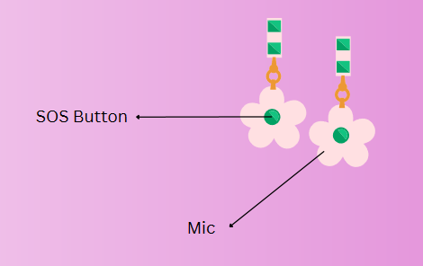
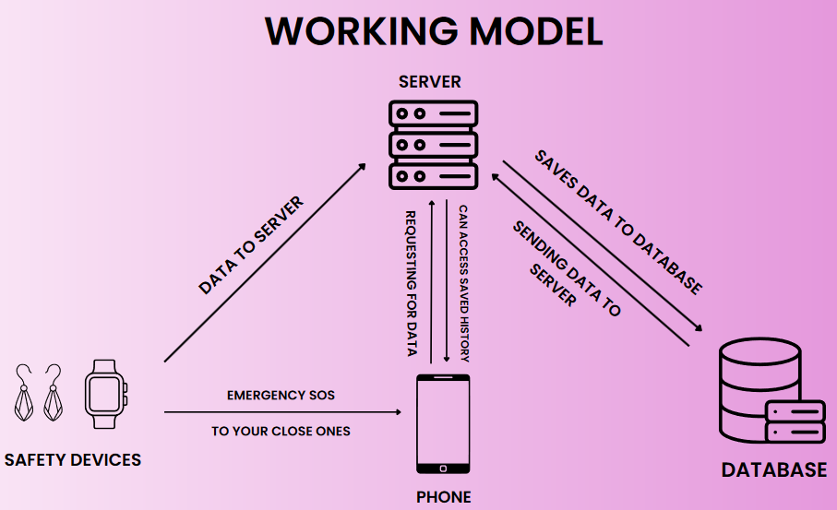
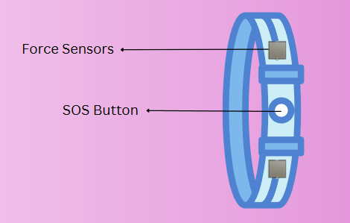
Idea/Approach Details
Describe your Use Cases here
Describe your Dependencies / Show stopper here
Emergency Alerts for Immediate Help.
Community Support and Advice.
Women's Safety Education and Self-Defense.
Real-Time Location Tracking for Loved Ones.
All-in-One Safety Solution.
Awareness Campaigns and Partnerships.
Self-Defense and Safety Workshops.
Versatile Safety in Various Situations.
Confidential Reporting of Incidents.
User-Friendly Interface for Quick Access.
Dependencies:
Third-party libraries and APIs
Hardware and infrastructure
Data sources
Team collaboration
Regulatory and legal compliance
Show Stoppers:
Security vulnerabilities
Critical bugs and errors
Funding shortage
Legal issues
Crisis situations
Loss of key personnel

Slide 4
Team Member Details
Team Leader Name: Radha Krishna Garg
Branch (Btech/Mtech/PhD etc): B.Tech Stream (ECE, CSE etc):CSE Year (I,II,III,IV): III
Team Member 1 Name: Krishna Sinha
Branch (Btech/Mtech/PhD etc): B.Tech Stream (ECE, CSE etc): CSE Year (I,II,III,IV): III
Team Member 2 Name: Md. Anas Jamal
Branch (Btech/Mtech/PhD etc): B.Tech Stream (ECE, CSE etc): CSE Year (I,II,III,IV): III
Team Member 3 Name: Aryan Gupta
Branch (Btech/Mtech/PhD etc): B.Tech Stream (ECE, CSE etc):CSE Year (I,II,III,IV): III
Team Member 4 Name: Tanmay Saxena
Branch (Btech/Mtech/PhD etc): B.Tech Stream (ECE, CSE etc):CSE Year (I,II,III,IV): III
Team Member 5 Name: Gudla Nishika
Branch (Btech/Mtech/PhD etc): B.Tech Stream (ECE, CSE etc):CSE Year (I,II,III,IV): III
Team Mentor 1 Name: Type Your Name Here
Category (Academic/Industry): Expertise (AI/ML/Blockchain etc): Domain Experience (in years):
Team Mentor 2 Name: Type Your Name Here
Category (Academic/Industry): Expertise (AI/ML/Blockchain etc): Domain Experience (in years):

Slide 5
Important Pointers
Please ensure below pointers are met while
Kindly keep the maximum slides limit to 4 pages
All the topics should be utilized for description of your idea
Try to avoid paragraphs and post your idea in points
Keep your explanation precisely and easy to understand
Idea should be unique and novel. If it has a business potential more weightage will be given.
Apart from this PPT abstract of your idea will be asked separately while submitting
You need to save the file in PDF and upload the same on portal. No PPT, Word Doc or any other format will be supported
You can delete this slide (Important Pointers) when you upload the details of your idea on SIH portal.

